Slide 1

HEAVY VEHICLE SECURITY
Web Authorization :
i) Yan Wang
ii) Subramaniam Ramanathan Murugappan
iii) Saptarshi Chatterjee
Virtualization :
i) Mu-An Liang
ii) Ting- Chang Yu
iii) Aniruddha Malkar

Slide 2
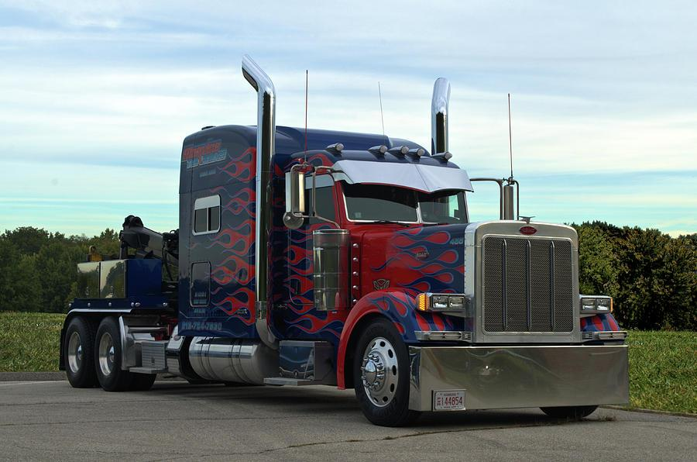
CONTENTS
Introduction
Why Heavy Vehicles
Penj1939
Website
Request and Response
SSH and VPN Post Authorization
OS
Conclusion
References

Slide 3
WHY HEAVY VEHICLES
Heavy vehicles are vulnerable to cyber attacks
More attack surfaces than passenger vehicles
Heavy Vehicles use the common communication protocol, J1939
Proprietary firmware and communication protocols may also be vulnerable
● Heavy vehicles are high value targets
● Timely and effective solutions are needed

Slide 4
PenJ1939
● Webpage
Simple UI with that provides access to physical testbed, vulnerability database, and user forum
● Physical Testbed(s)
Multiple networks of ECUs that may be accessed remotely
● Database
Vulnerabilities, exploits, and attack traffic
● Extensive Privacy and Access Controls
Protects manufacturers’ identities and Intellectual Property

Slide 5
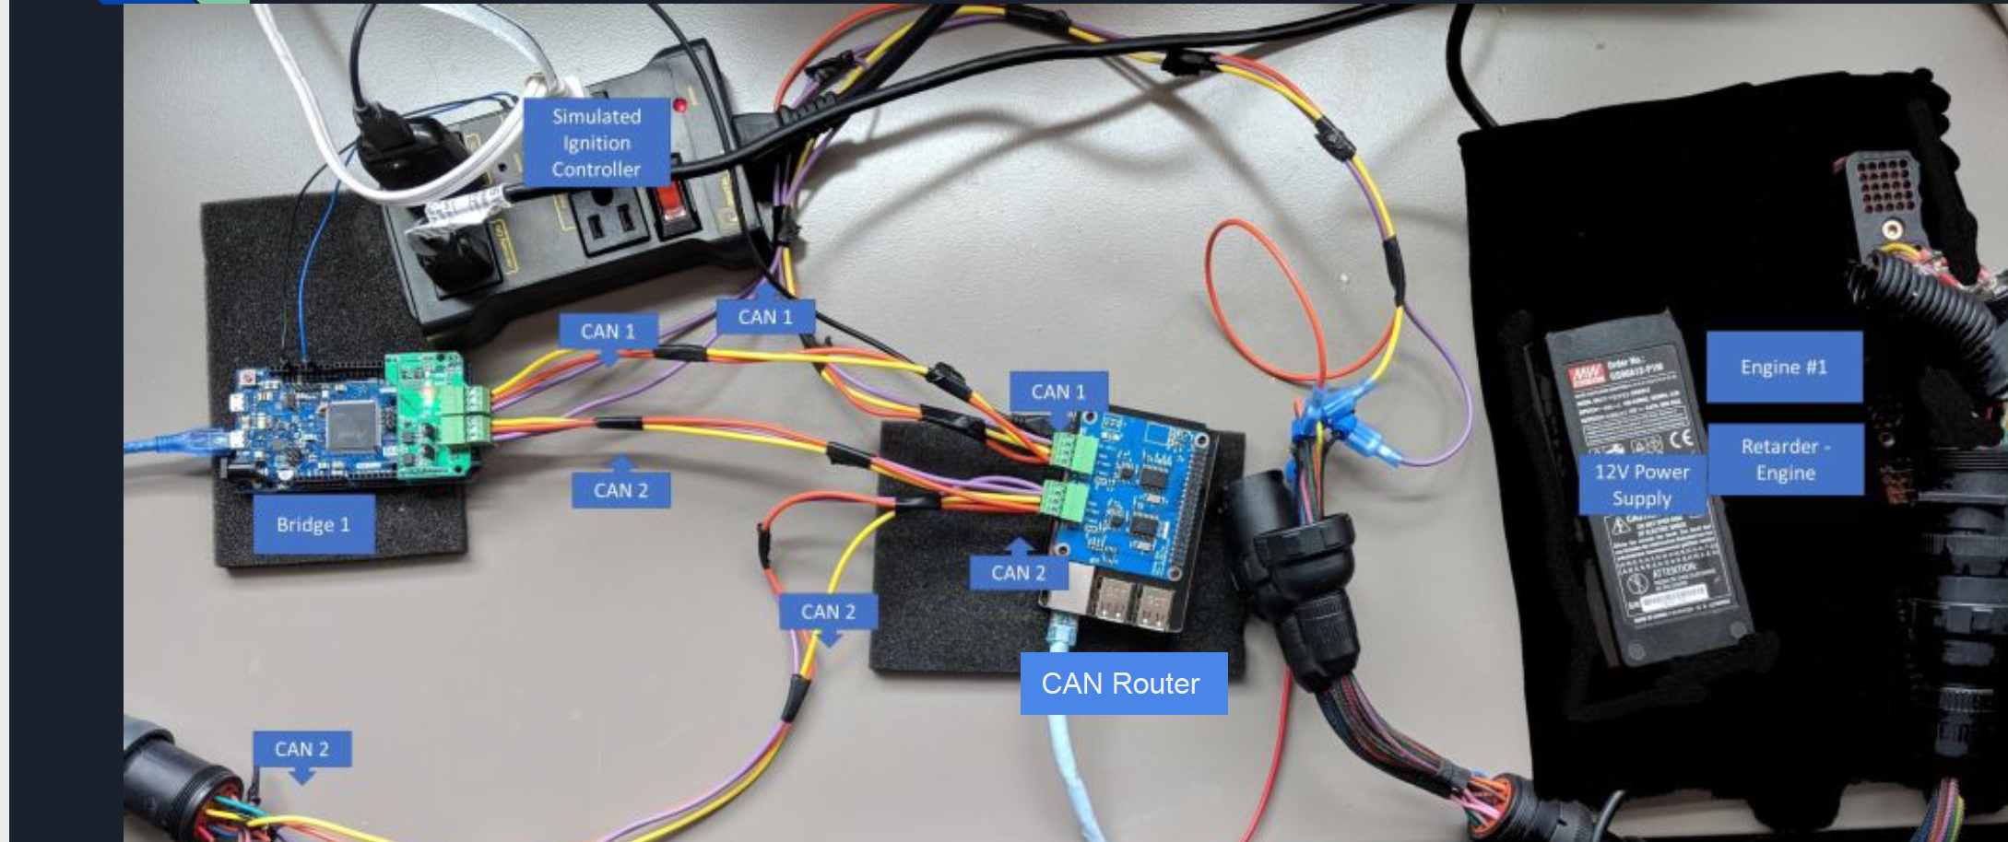
The Physical Testbed

Slide 6
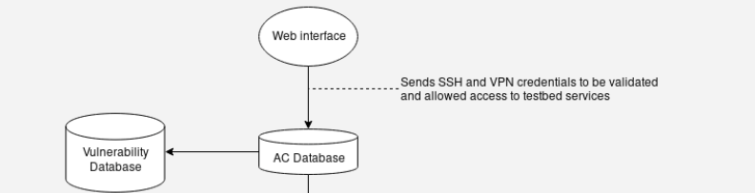
Website

Slide 7
Website
Registration and log in
User creates account
Login
Request Testbed Component access on the website
Obtain the information from the database
Change the function of the ‘request’ button

Slide 8
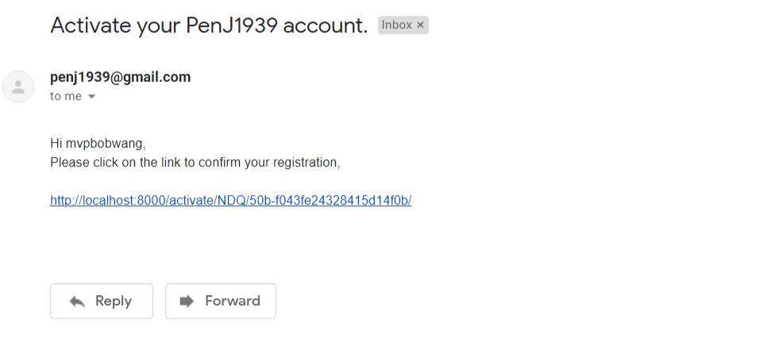
Website

Slide 9
Website
3. Response from the web server
Send the e-mail to the user post credential validation
Alert the user to check the email
The user obtains the link in the email
4. Check the information of the account
Make sure the link is unique for that user and sessionwith proper timeouts
Allow access to the VPN and SSH details if user is authorized

Slide 10

Website

Slide 11
Website
5. Security of the link
The access/timeout token
Times out after 30 minutes
The user identification
If user is not logged in at the time they clicked the link, redirect to login.
6. Log in and confirm the information
If credentials are authorized, display SSH & VPN details for the components to user

Slide 12
Virtualization Environment
Notes:
Introduction virtualization environment, product theory when we develop any product we ask ourself why we are creating this product how it differs from the other. as my colleague has answered this question. I will be presenting the problems occured while developing the product and how I solved it.

Slide 13
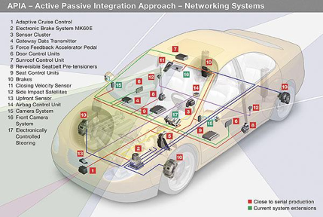
Why we need a real time physical testbed than a simulator?
Cyber physical systems are complex systems that controls physical parameters in system/ plant.
For comprehensive monitor & control they require complex interaction between each other
Simulator don’t produce accurate results as the real time operation and result are hard to predict.
To test the heavy vehicle security accurately we need an accurate physical real time cyber physical testbed.
Notes:
3 point simulators are created based on observation but cyber physical real time system are hard to observer and predict their actions.

Slide 14
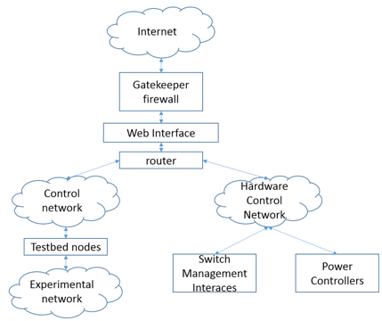
Why we need an Open source testbed?
The Deter lab project has changed the way of looking towards testbed
Deter lab is a open source electronic testbed allow users to test computer/internet attacks and allow users to test their solution
Deter run all the experiments simultaneously into testbed
But the Deter don’t have any facility to test heavy vehicle security
The heavy vehicle security is getting more sensitive and vulnerable now. There is a high requirement of Open source cyber physical testbed that allows users to parallelly access the different models of heavy vehicles.

Slide 15
What is the problem of creating Deter like testbed?
Problem 1: The Deter lab allow users to access the testbed through SSH like of the computer node inside the testbed created for the user.
But such access can’t be provided in Heavy Vehicle testbed due to two reasons: 1) The node inside the testbeds are ECUs and ECUs can’t handle normal commuting operations. 2) Even getting such SSH access won’t provide users a comprehensive analysis.
The Heavy vehicle testbed is a cyber physical testbed requires extraordinary security
We can allow users to access the testbed from their computer. It may harm users’, testbed and vehicle manufacturers security.

Slide 16
What is the problem of creating Deter like testbed?
Problem 2:
The Heavy vehicle testbed is a cyber physical testbed requires extraordinary security.

Slide 17
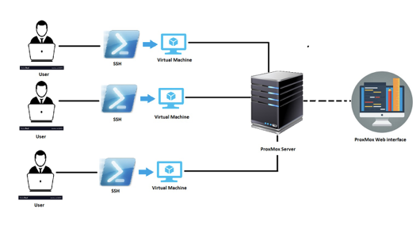
How we solved first problem?
Virtualization environment has solved many problems including this
The Virtualization environment allow us to create the VM, deploy VM.
We connect the physical testbed with the virtualization environment. Where we provide access to the users through the VM that is directly connected with the physical testbed.
Virtualization environment solves two problems: 1) Parallel access to the testbed 2) Security issue in problem 1
Notes:
we require something in between the user and testbed that allow them to communicate securely.

Slide 18
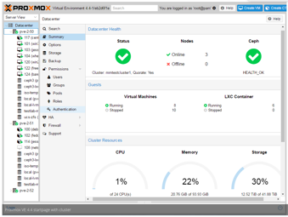
How I set virtualization environment?
ProxMox is an open source environment that allowed me to create virtualization environment.
We installed customized Ubuntu OS for VMs and provided access through the VM.
Notes:
customized the ununtu to provide the ssh into VM from outer networking environmenrt.
baremetal hypervisor

Slide 19
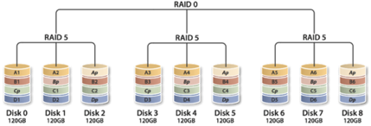
How I set virtualization environment?
For better availability I used RAID 50 technique that sustains the disk failures.

Slide 20
What else?
We need a communication socket that will send the converted CAN packets (in TCP form) to VM that allows users to monitor the CAN network.
We need another socket that will transfer the converted CAN packets (in TCP form) from VM to testbed to allow user to implement the attack.
Problem:
Need two bidirectional continuous sockets that consumes lot of host resources causes translating program to lose some CAN packet.
Solution:
Used multiprocessing library of the Python that smartly uses the resources of the hosts and prevent losing CAN packets.

Slide 21
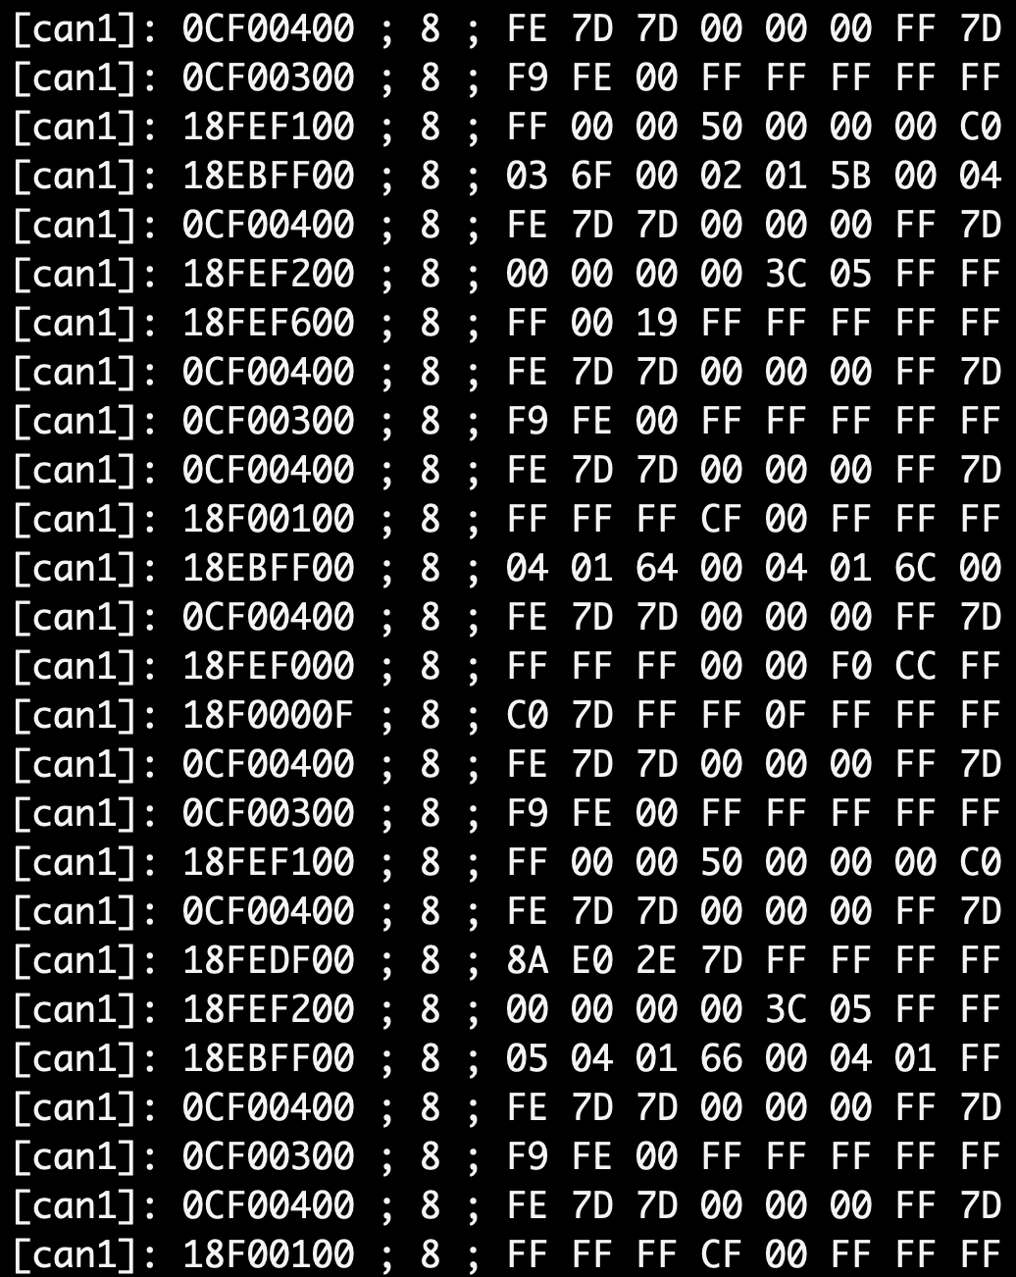
Results:
We captured this result at VM ssh from the user.
We are able to monitor the CAN messages flowing through CAN Network.
CAN| Data
name| CAN ID |length|B0- B1-B2-B3-B4-B5-B6-B7 |

Slide 22
Future Work
Solving problem 2 using the XACML, an attribute based access control.

Slide 23
CAN data filter
Mu-An Liang
Notes:
Hi. I am Mu-an Liang
I am gonna introduce the topic CAN data filter.

Slide 24
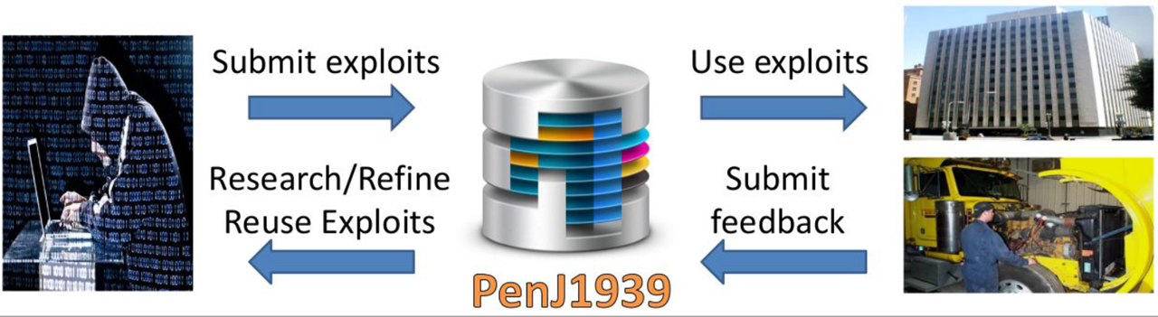
General Background
General Situation: Most Vehicles use CAN bus J1939 to connect all ECUs. General Question: Heavy vehicles are vulnerable to malicious cyber attacks. How do we handle it? General Answer: PenJ1939 system is a way to collect automotive exploits and attack data, which can improve the security without testing on live vehicles or buying real vehicles.
Notes:
Now the
General Situation is this: The most popular communication protocol on heavy vehicles is CAN bus J1939. Almost all ECUs on heavy vehicles are connected by J1939.)
What is the problem here? If one malicious attacked ECU is installed, all the ECUS connected to the Can bus will be controlled by hacker and the driver will have no awareness, which is easily to cause serious accidents. As a result, heavy vehicle security is an important issue.
Here is the Answer: PenJ1939 system, an access-controlled, privacy-preserving Cyber-Physical Testbed is a way to collect automotive exploits and attack data, which can improve the security without testing on live vehicles and buying real vehicles. Testing platform that allows users to have access to real hardware and exploit database for J1939 protocol (includes simulated ECU attacks which can help users to find a solution of heavy vehicle security).

Slide 25
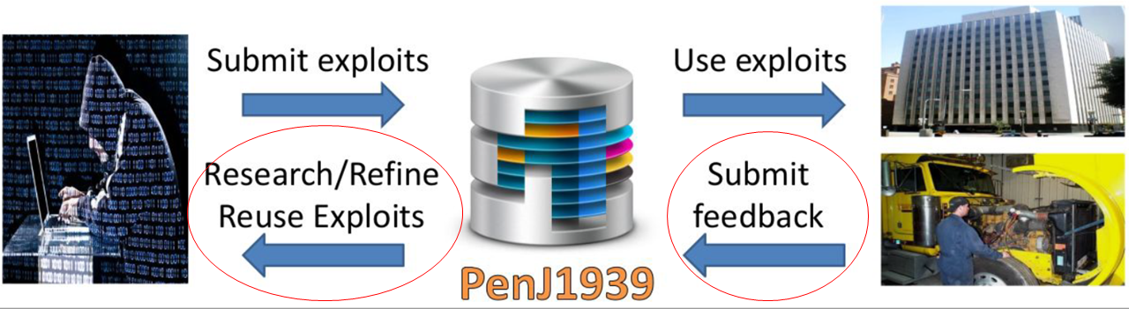
Let’s be more specific
What will be a problem in the system?
The risk of vender’s vehicle components.
The users might destroy the vehicle components or steal some private information.
Notes:
But what is the problem in the system?
The system needs some venders to provide components of vehicle on testbed. The venders’ components might be cyber-attacked and destroyed. Even though the vender can access all the data without testing, they still have certain level of risk to prevent they provide their components.

Slide 26
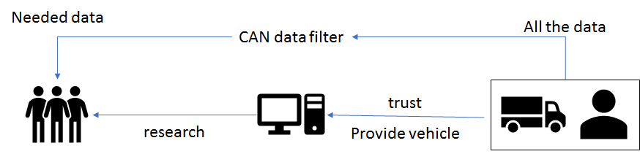
Why we need CAN data filter?
Related Question: Venders’ Security
Best Answer: CAN data filter on OS level
If all the secured data can be filtered, the server can prevent the cyber attacks and also protect everyone’s privacy.
Notes:
As a result, the transferring data security is the most concerned issue of venders, which can guarantee venders’ security. the CAN data will be transferred with system level filter to achieve the highest security of data transferring.

Slide 27
OS level data transferring
The connection between user, server and provider are vulnerable. However OS level data transferring cannot be accessed without permission. There are two methods, The first one is the modified rule of iptables. The other way to do the transferring data filter is USB filter.
Notes:
A general service includes client servers, host server and remote controlling components. The connection between all these servers are vulnerable. However, if the data flow can be controlled in the operating system (OS) level. The data security will obviously increase. Because the secured data in the kernel cannot be accessed without the permission of the host server and the secured data cannot be tracked in OS level. There are several methods can achieve this high secured data transferring. The first one is the modified rule of iptables. The client needs the firewall framework which consists of iptables and netfilter to transfer their setting and data to the host. As a result, the customized rule of iptables can filter CAN message at the OS level, which causes the hackers cannot try to defeat our filtering rules at the application level. However, the iptables filter needs to transfer data through Internet, which might slow down the CAN data transferring at certain level.
The other way to do the transferring data filter is USB filter. The USB filter is embedded in Linux kernel is an accessible way to filter the data and it can be ported to different environment by modifying the USB protocol rule. The USB protocol are popular in many intelligent devices. As a result, the USB filter can be adapted to many different environments. The USB filter can freely disable/enable the connection between the host server and the client, the host server and the remote controlling component. By controlling the rule of USB Filter, the secured data flow can also be kept in the OS level and raise the security.

Slide 28
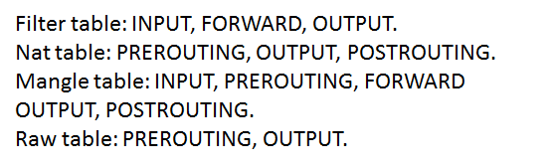
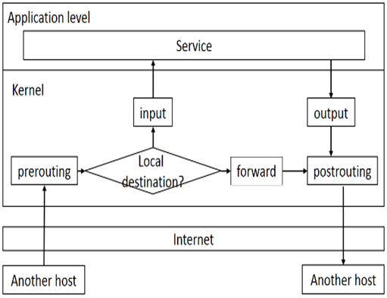
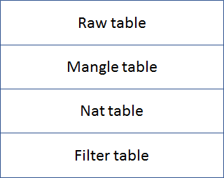
Iptables in linux
It can be divided into five chains and four tables.
Notes:
The iptables firewall can be divided into five hooks which includes PREROUTING, INPUT, FORWARD, OUTPUT and POSTROUTING, each of them is responsible for different work. INPUT chain means the destination address of packet is local. FORWARD means the destination address of packet is not local. OUTPUT means the packet is generated in local system and the packet will be sent to the address not belong to local. PREROUTING is processed every packet from Internet before any the packet is decided where to send the packet. After the packets are transfer to OUTPUT and FORWARD, the packets will be transferred to POSTROUTING before the packets are sent to another host. There are four kinds of table in iptables: filter table, Nat table, Mangle table and Raw table. They are responsible for different task. Filter table is firewall and kernel address of filter table is iptables_filter. Nat table processes network address translation. Nat table is often used to route packets to network when direct access is not possible and kernel address of nat table is iptables_nat. Mangle table alters the IP headers of the packet and kernel address of mangle table is iptables_mangle. Raw table provides a mechanism for marking packets in order to opt-out of connection tracking and kernel address of raw table is iptables_raw. The priority of these tables from high to low is raw table, mangle table, nat table and filter table. Each table consists of different hook. Filter table consists of INPUT, FORWARD, OUTPUT. PREROUTING, OUTPUT, POSTROUTING are included in Nat table. Mangle table is composed of INPUT, PREROUTING, FORWARD OUTPUT, POSTROUTING. Raw table consists of PREROUTING, OUTPUT.

Slide 29
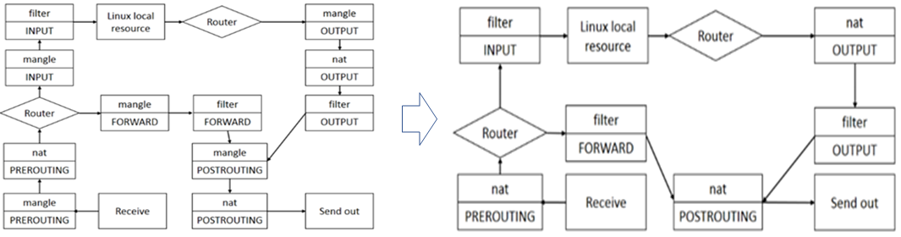
The system structure
The system structure can be simplified from left to right in PebJ1939 system.
Notes:
In the cyber-physical testbed, mangle table is seldom used. As a result, the data transferring structure can be simplified as

Slide 30
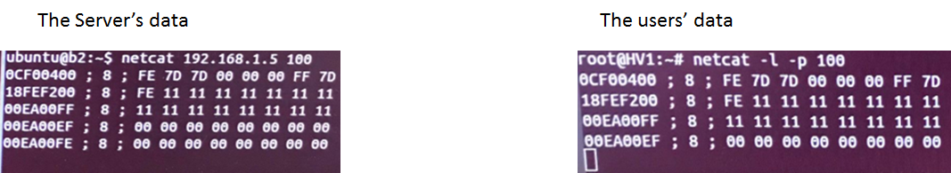
Experiment
By understanding the iptables structure in PenJ1939, the filter INPUT hook will be applied filter rule. In the experiment, the CAN data “00EA00FE” is vender’s secret data which cannot be accessed by normal users.
Notes:
In the experiment, the netcat is used to set the transferring port, by using the command “netcat -l -p 100” in receiver’s terminal and “netcat 192.168.1.5(receiver’s ip) 100” in host’s terminal, the port 100 will be used to transfer the packets. The ip address 192.168.1.7 is the host which is sending TCP CAN data to 192.168.1.5 via port 100. The iptables default policy is ACCEPT. The applied iptables rule is “iptables -t filter -I INPUT -m string –algo bm –string 00EA00FE -p tcp -j REJECT”, which means any TCP packet which contains 00EA00FE will be rejected. The experiment results are shown below as Fig 4 and Fig5. Fig.4 is the terminal of the host sending CAN data to Fig.5 the VM. The host sends “0CF00400”, “18FEF200”, “00EA00FF”, “00EA00EF” and “00EA00FE” in turn. And after the “00EA00FE” is sent to the VM. The data “00EA00FE” is rejected in the kernel of VM. As a result, the “00EA00FE” cannot be found in the application level of VM.

Slide 31
Conclusion/Further research
The iptables function is powerful and easy to be modified in terminal. However, the structure of iptables is complex.
In the further research, the iptables should be ported to non-Internet transferring. As a result, the powerful iptables rules will be applied to different kinds of data transferring (USBfilter), which will be very useful for different kinds of communication.
Notes:
The CAN data filter can be divided into two parts, on the application level, CAN data is transferred to TCP packet which can be filtered by iptables. After the translation, the CAN system sends the packets to the VMs and the VMs apply the AC rules during the CAN data transferring on the system level. This is a simple way to do the CAN data filter without modified kernel code. The iptables function is powerful and easy to be modified in terminal. However, the structure of iptables is complex. The researchers need to understand the structure first then do the modification or the iptables resources will be wasted. In the further research, the iptables should be ported to non-Internet transferring. As a result, the powerful iptables rules will be applied to different kinds of data transferring (USBfilter), which will be very useful for different kinds of communication.

Slide 32
Communication
1. Devices
Raspberry Pi
Carry ECU via CAN bus
VMs
User interface
2. Programming
Socket programming in Python33

Slide 33
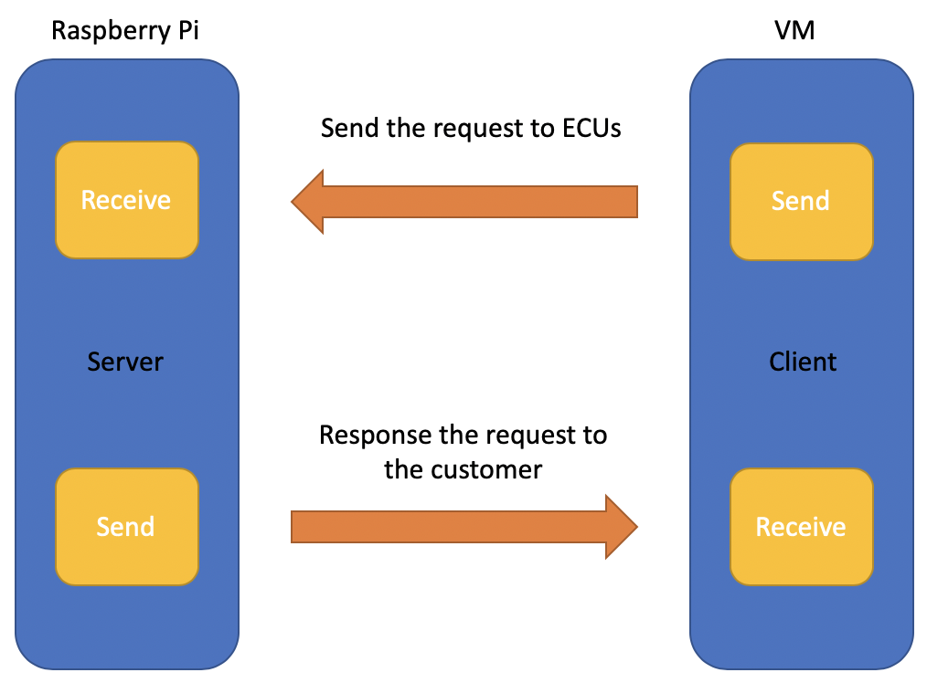
The structure of the communication

Slide 34
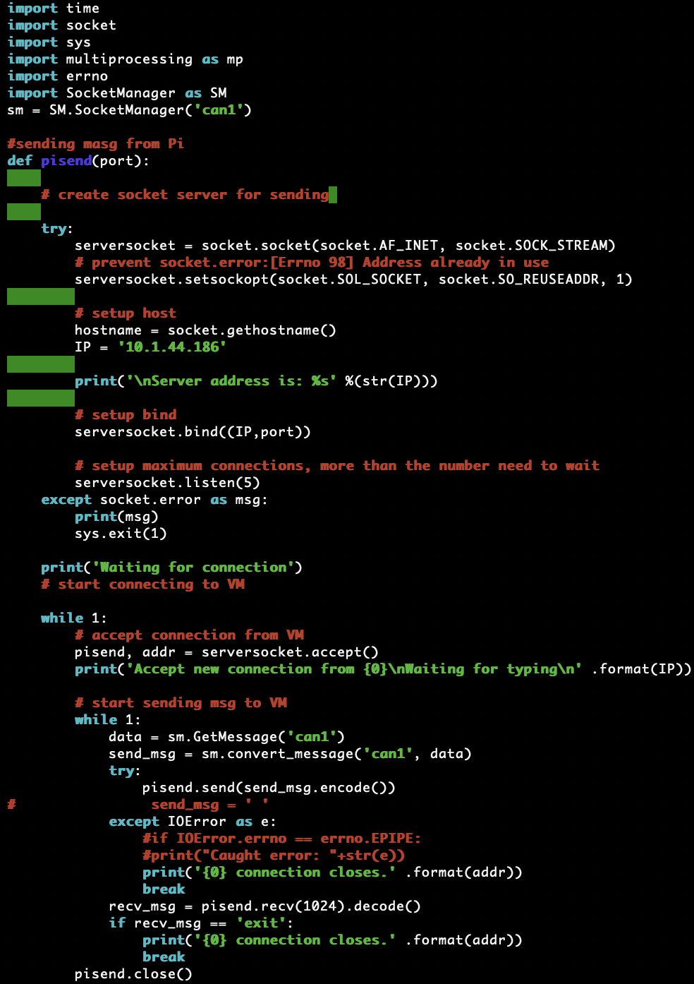
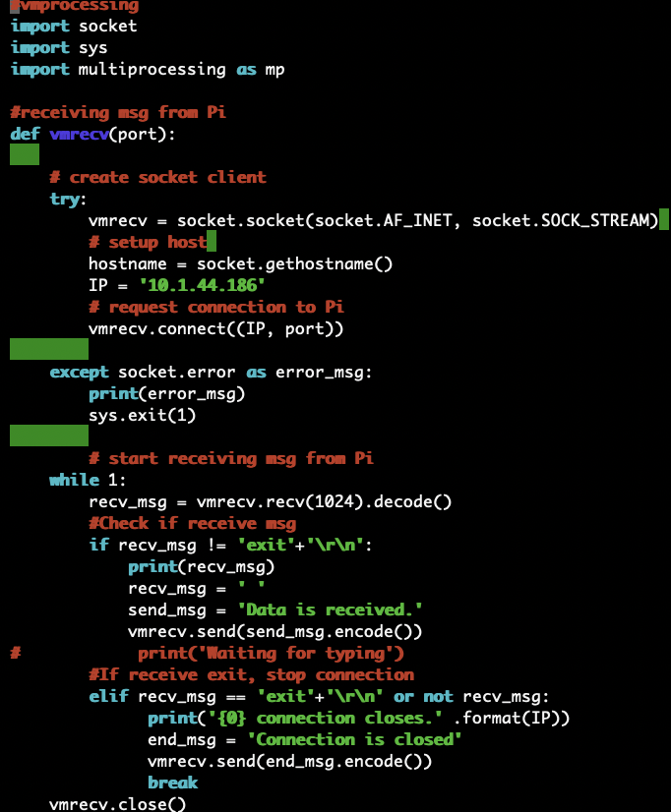

Slide 35
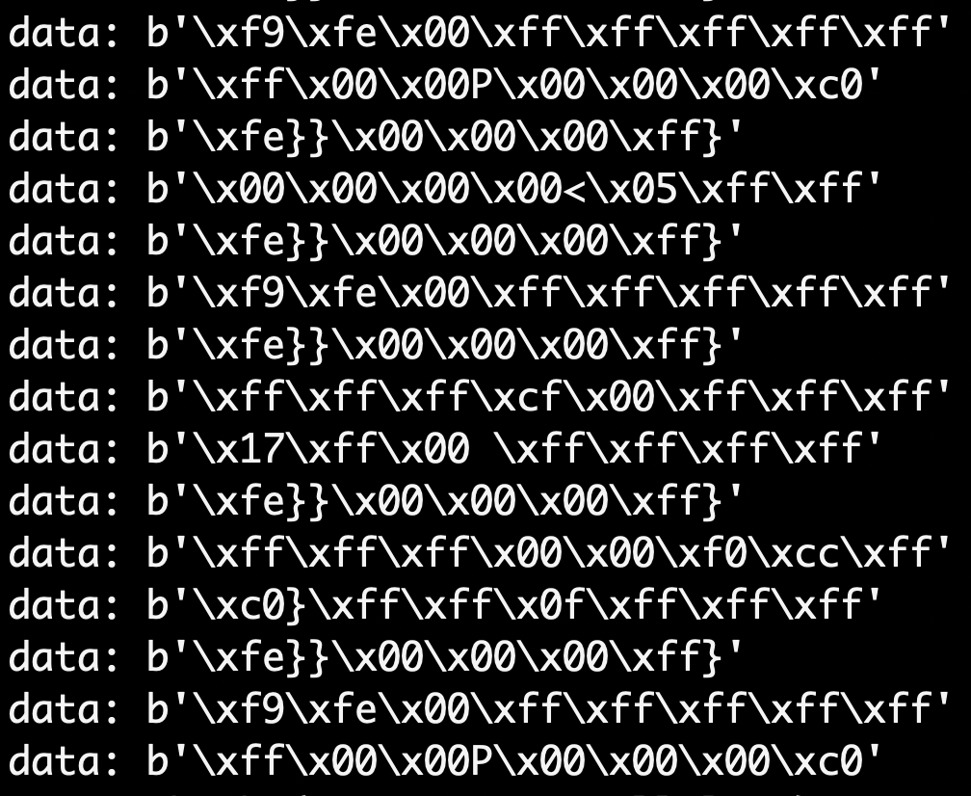
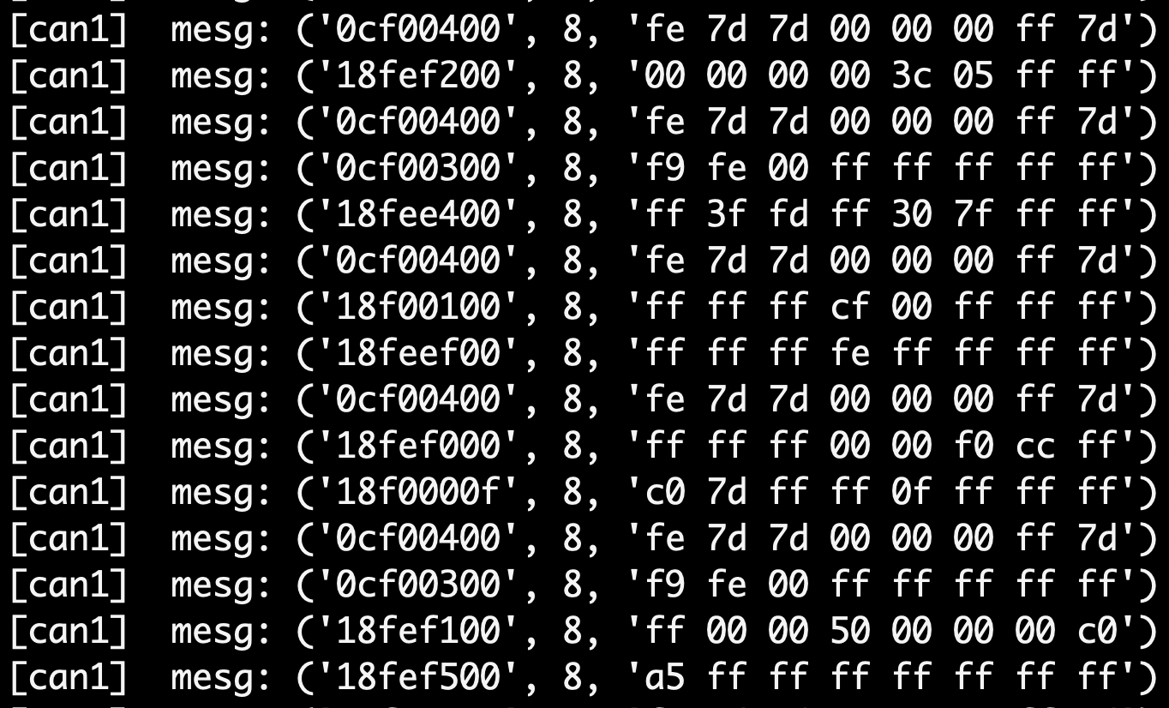
Format the data from CAN bus
CAN name CAN ID data length data

Slide 36
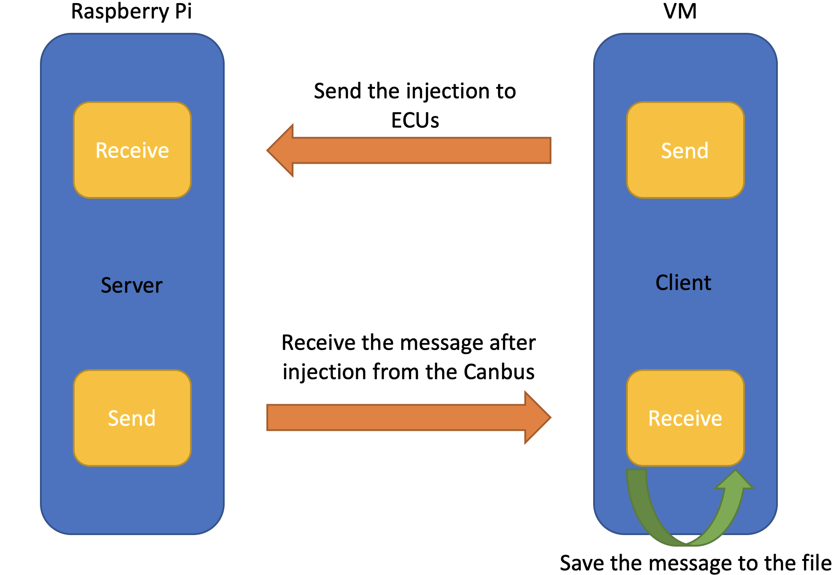
Injection in CAN bus in ECUs

Slide 37
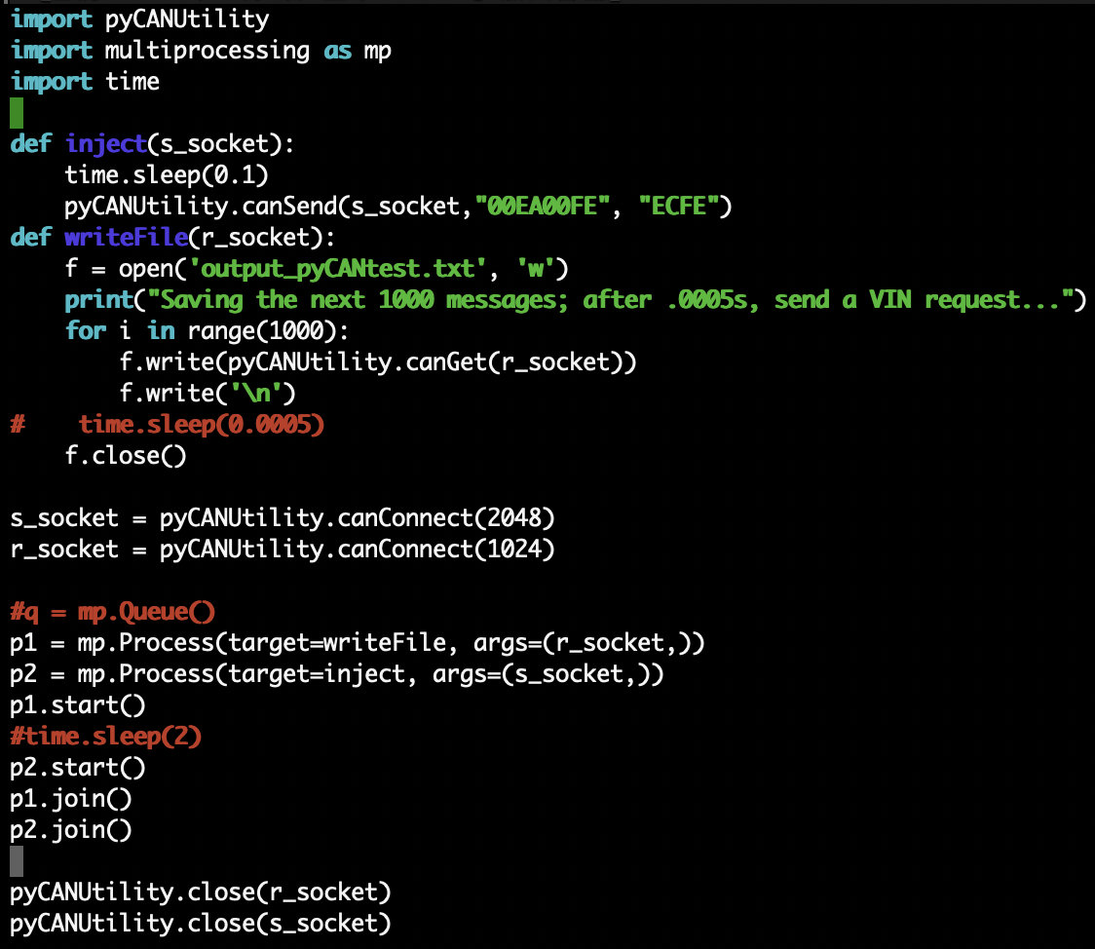
The code of the injection

Slide 38
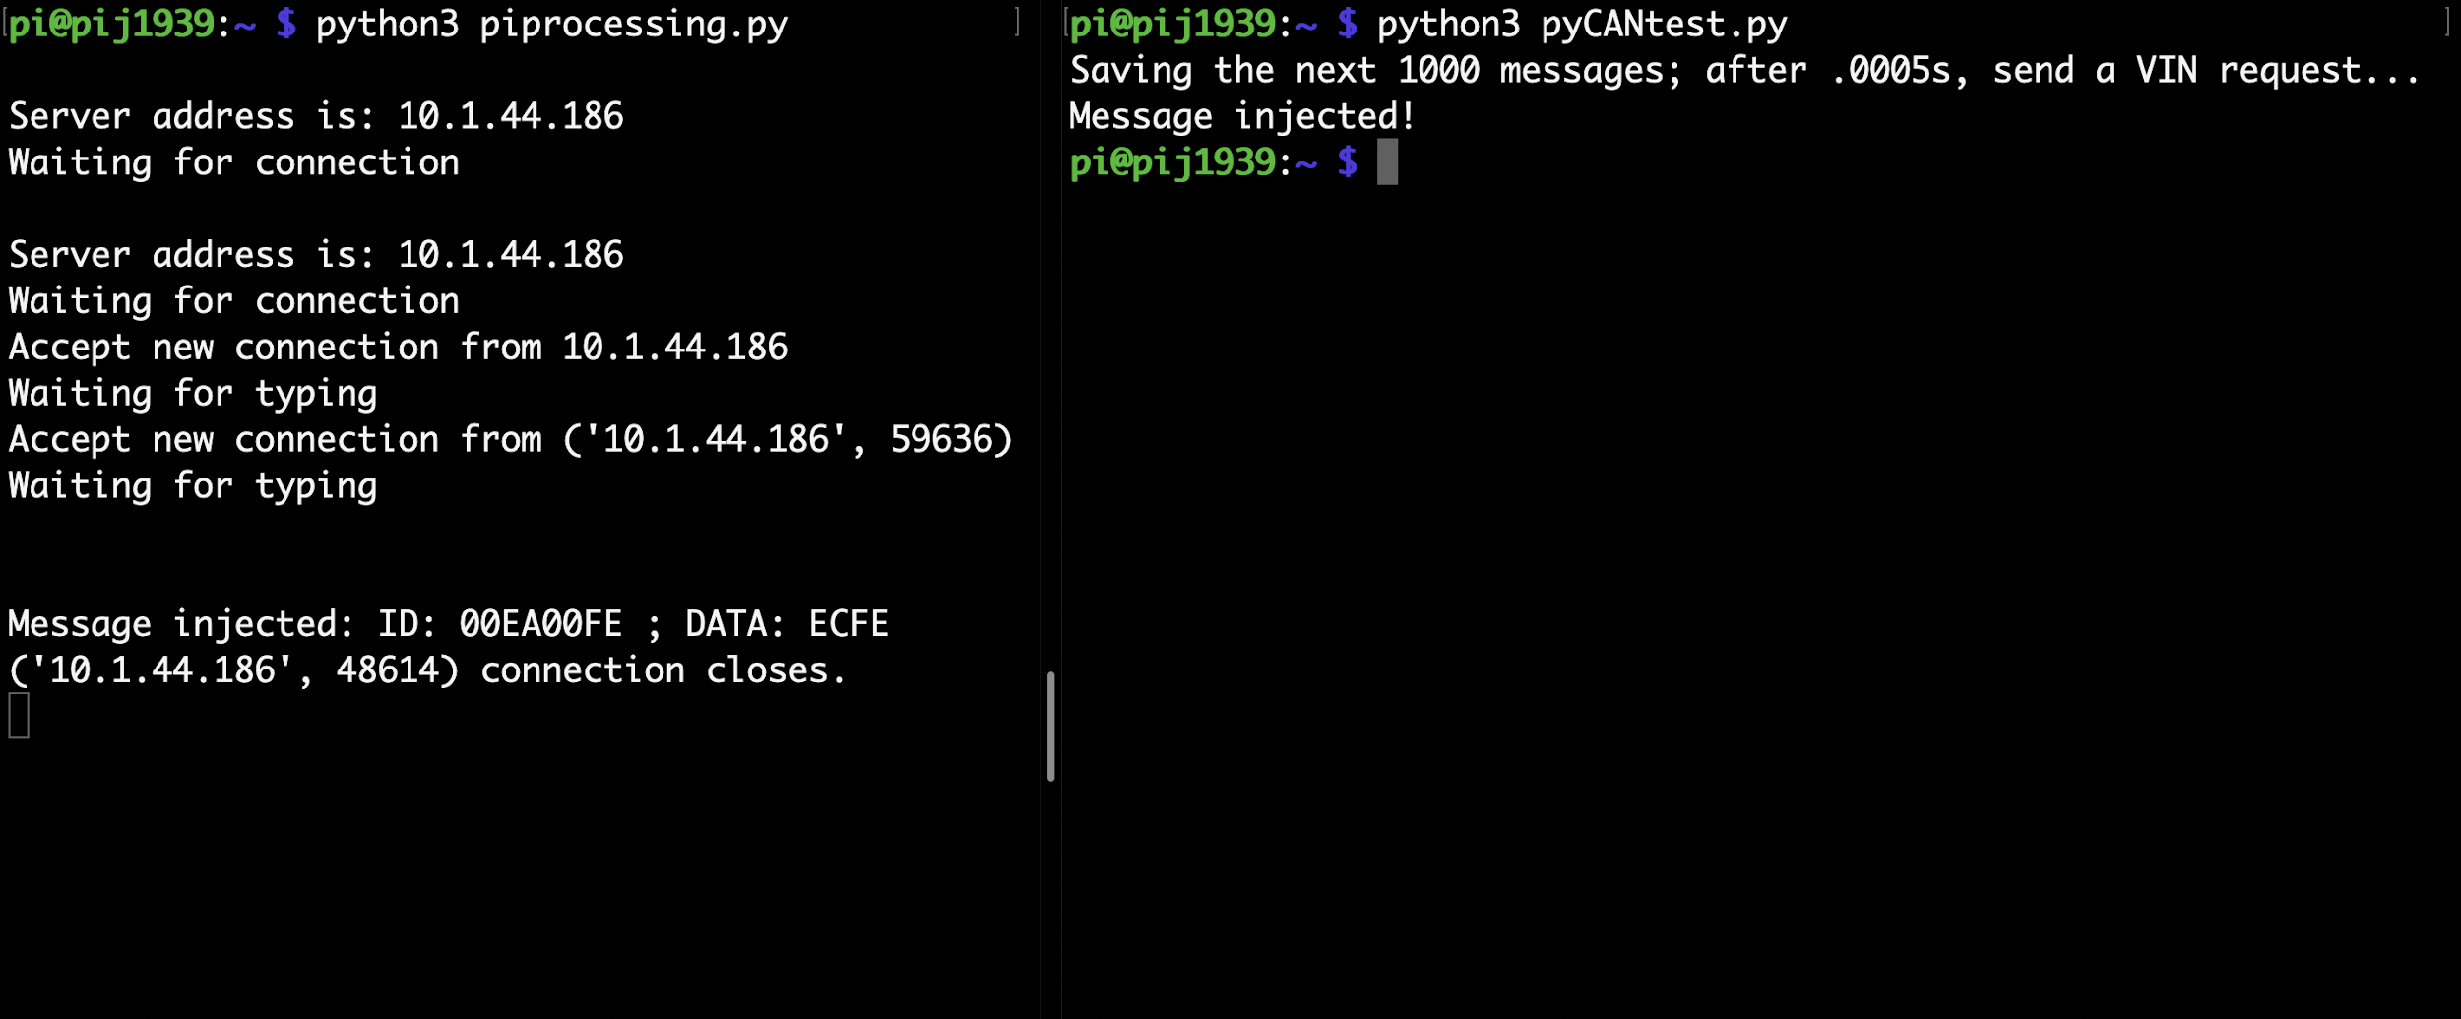
The result of the injection experiment

Slide 39
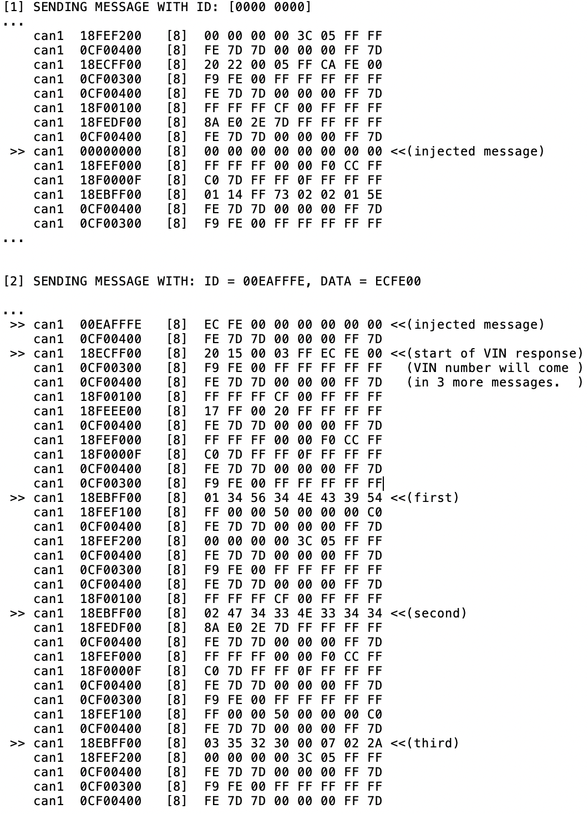
Detail for the injection

Slide 40
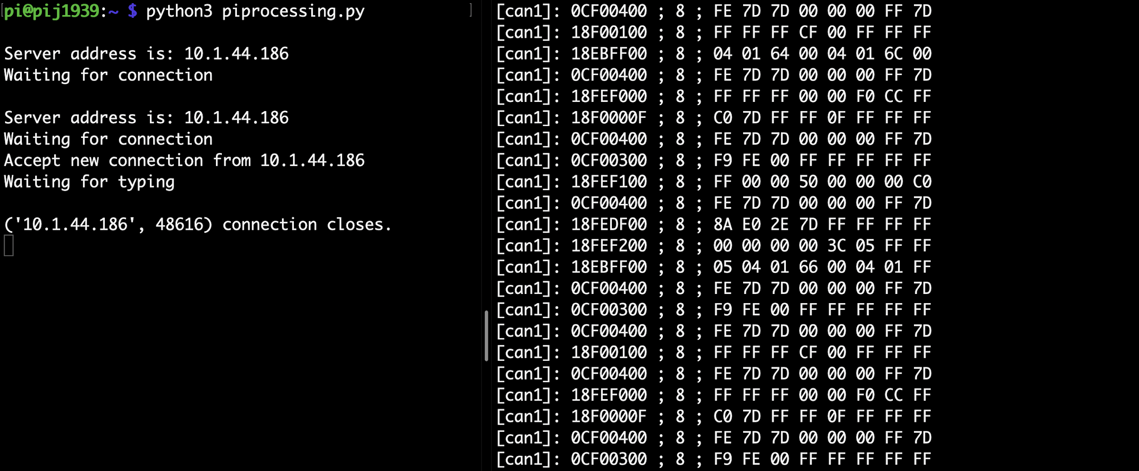
More examples

Slide 41
Future Work
1. Extend the use of injection
ECU communction
Avoid potential accidents
2. Extend the use of GetMessage function
Better use for technician

